Slide 1
SMART TRANSPORTATION STATUS
…….a smart city dedicated app for smart people

Slide 2
Have it ever happened with you, you planed to go somewhere and stuck in waiting for public transport vehicle to arrive at stop.
Have it happened with you, You're at quiet a distance away from auto stand, and you need to take the auto. Ultimately you need to go by walk to all the way around to auto stand and take the auto.
Have you been stuck in situation where its for sure that you need to take public transportation but stuck in turmoil situation which one to take and is nearest to you.
SAMRT CITY TRANSPORT APP IS ANSWER TO ALL……

Slide 3
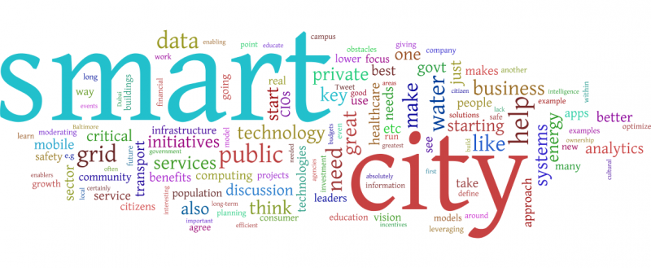
So, what’s make the City Smart??
According to Wikipedia, A smart city is an urban development vision to integrate multiple information and communication technology (ICT) and Internet of Things (IoT) solutions in a secure fashion to manage a city’s assets – the city’s assets include, but are not limited to, local departments' information systems, schools, libraries, transportation systems, hospitals, power plants, water supply networks, waste management, law enforcement, and other community services. The goal of building a smart city is to improve quality of life by using urban informatics and technology to improve the efficiency of services and meet residents’ needs.

Slide 4
Initial Setups
This one need to be done by the government or concerning transportation body. ( BMTC for ex in Bangalore)
Every bus, auto, train and metro should have a GPS and connected and respond to server.
All GPS id should have the corresponding vehicle details stored in database.
Real time monitoring of all vehicles.

Slide 5
Requirements
A smart phone, it can be (Android, Windows, iOS).
Internet connection.
And willingness to travel…

Slide 6
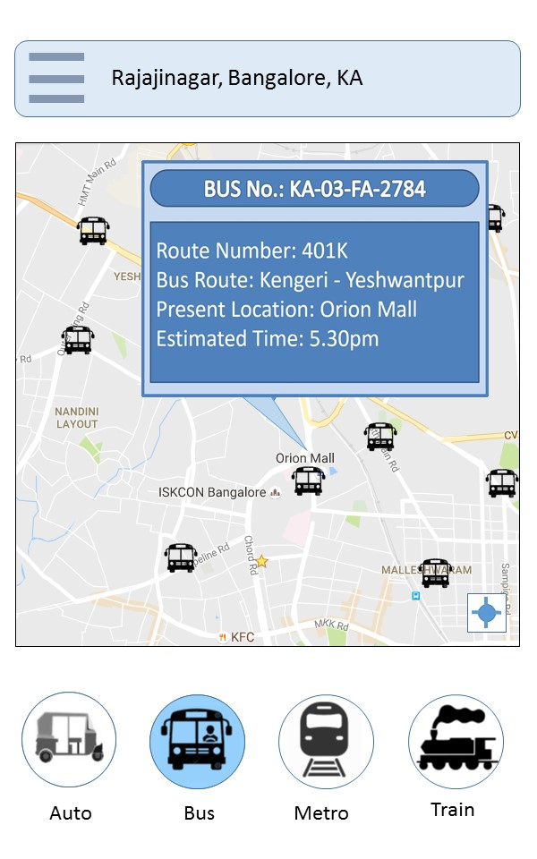
The App start with the bus page as default.
Bus is most common and frequent used transport system.
What’s on the bus page APP?
Screen will show integrated map based on GPS location.
The map will represent all the near by bus location in real time.
Once we click on the bus, we can get the detail on the selected bus.
The details include common descriptions like, Bus No, Route No of the bus, Bus Route, Present Location and Estimated time to most near bus stand.

Slide 7
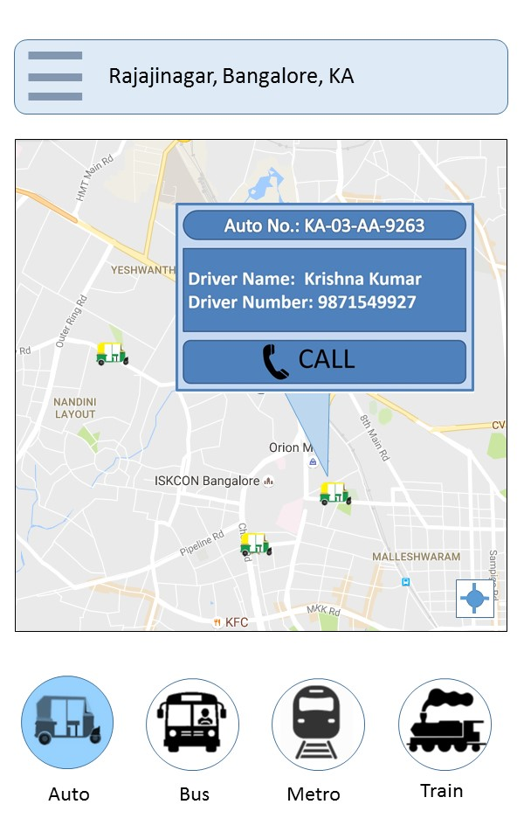
Whats on the Auto page ?
The map will represent all the near by Auto location in real time.
Once we click on the auto, we can get the detail on the selected auto.
The details include common descriptions like, Auto no., Driver name, Driver Number and Present Location.
There is call feature in auto section and you can call and request the auto at you’re position.

Slide 8
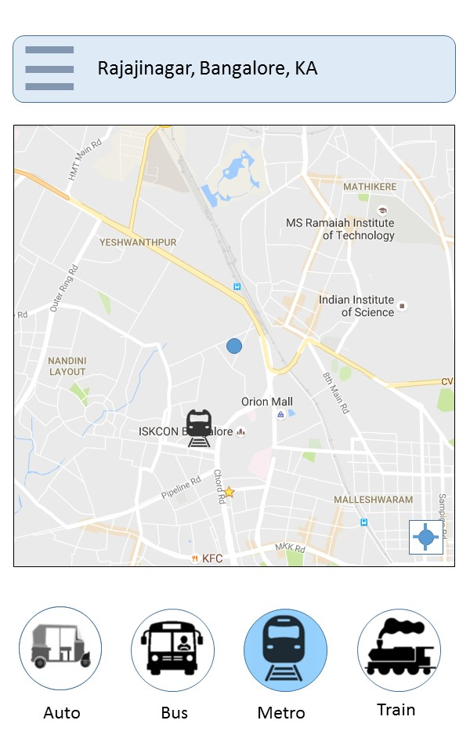
Whats on the Metro page ?
The map will represent metro train location in real time.
Once we click on the metro train icon from map to get the detail on the selected train.
The details include common descriptions like, Metro Train no., route, Present Location and Estimated time to most near metro station.

Slide 9
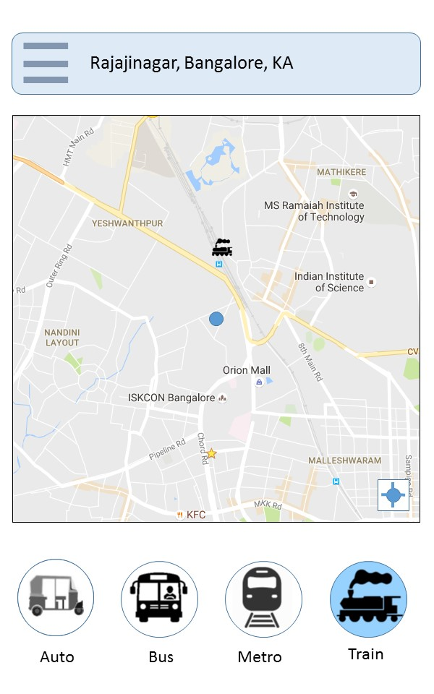
Whats on the Train page ?
The map will represent train location in real time.
Once we click on the train icon from map to get the detail on the selected train.
The details include common descriptions like Train no., route, Present Location and Estimated time to most near Railway station.

Slide 10
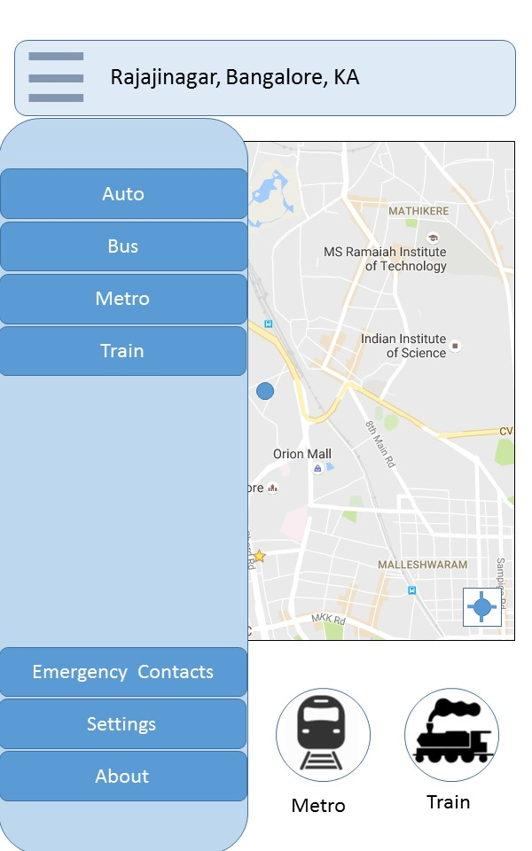
The Slide Screen Page
On selecting the Hamburger icon we can access all the features, including some additional options like, Emergency Contacts, Settings and About the Application

Slide 11
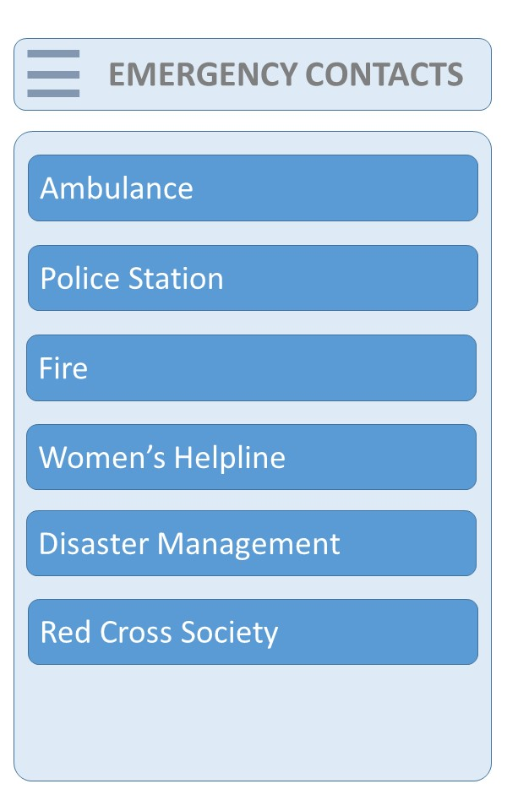
Emergency Contact Page
While travelling there is always a jeopardy and we need to contact emergency services.
This page will help to call for those services
Ambulance : 102
Police Station : 100
Fire : 101
Women’s Helpline : 108
Disaster Management : 181

Slide 12
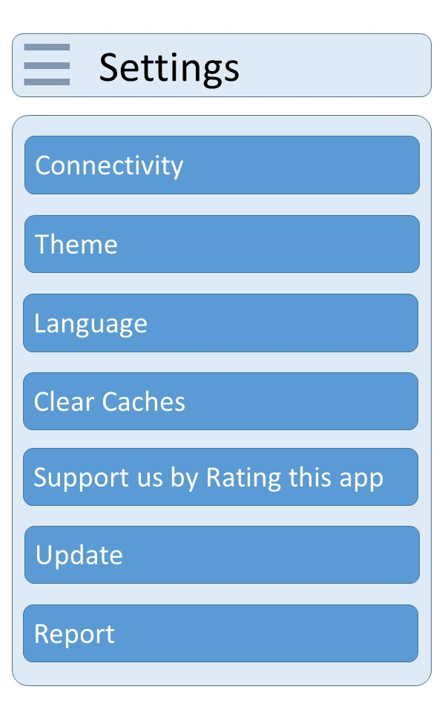
The setting page
This will allow the user to perform some tweaks in app.

Slide 13
Future Enhancement & Conclusion
Government can put up some app dedicated system on some station where public can use this natively.
Suppose there is situation in some place where there is no availability of the transport, so user can put up the request so that government can increase the frequency and number of transport service in that area.
The App will have the smart city users to manage and plan to travel using public transportation more efficiently.

Slide 14
THANK YOU
Made by-
RITESH RANJAN and Team
Ph: 9902064617
Email : prince2ritesh@gamil.com

